Slide 1
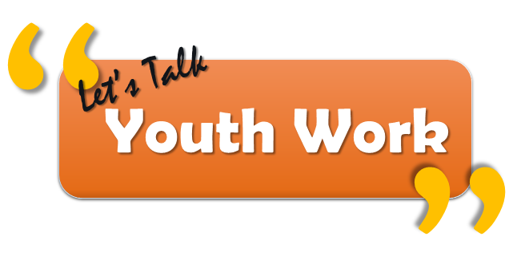
Notes:
The new Interim Youth Work Board for Wales want the views of young people to be central to the work it does. The Chair of the Board is Keith Towler. Keith and the other Board Members are very keen to start an ongoing dialogue with young people and use the relationships and expertise practitioners have to help facilitate this two way conversation (using youth work practice to inform youth work development).
We have provided a feedback sheet to summarise your conversations with young people and make it easier to collate the information they provide, this way we can identify what other pieces of work need to be done.
The following four questions are designed to start this process.
For more information on the role and function of the Board please go to:
https://cymru-wales.tal.net/vx/mobile-0/appcentre-3/brand-2/candidate/so/pm/1/pl/8/opp/4820-Appointment-of-Member-Interim-Youth-Work-Board/en-GB
We will ensure we keep both young people and practitioners informed about how we are using the information to inform our work and will be back in touch in response to the issues that young people raise.

Slide 2
We just have 4 questions we would like you to answer:

Slide 3
1. What does youth work mean to you?
Notes:
We are trying to establish how young people themselves define contemporary youth work (not what others say it is or should be).
Youth work is now very diverse, engaging young people aged 11 -25 in a number of settings.
Is there activities, venues, support, advice, guidance that they particularly associate with the practice?

Slide 4
2. What does youth work offer you now?
Notes:
Why do young people specifically access the provisions they do?
This is about their own personal experiences, there are no right or wrong answers.

Slide 5
3. What would you like youth work to offer?
Notes:
Having reflected on why young people currently access youth work provisions, this question is exploring whether they would change anything.
Do they want more emphasis on particular areas and less on others?
Is there things missing that should be included?
Should youth work offer something different?
As in question 1; this question relates to venues, support, advice, guidance, services…

Slide 6
4. How do you want to be involved in shaping youth work?
Notes:
The Youth Work Board for Wales want to keep young people involved throughout all aspects of its work. This is not just about keeping them informed but ensuring they are active participants in the process.
Can social media play a role? (if so, what platforms and why?)
Would young people prefer events, workshops?
Would they prefer information passed through workers?
It could obviously be a combination of all these or in fact totally new ideas.
It is important they feel like active, empowered stakeholders.

Slide 7
Thank you
Notes:
This is just the start of the conversation. We are committed to keeping young people involved and value your support, as workers, in helping us do this.
The information provided will help us develop our work as a Board.
Our next step will be to review the data provided and determine how to use the information.
Once this is done we will make sure young people and workers are informed as to how we are to proceed and how else they can play an active role in moving forward.

